Slide 1

Morning Joe: Visualizing Coffee Rust, Production and Futures
Data Visualization | Fall 2017 | Indiana University |
Final Presentation by Laura Kahn
https://thedatalass.com/morning-joe-viz-project/

Slide 2
Presentation Outline
Motivation
Scope
Existing Research
Data Acquisition
Data Analysis
Present Results

Slide 3

Motivation
More than 2 billion cups of coffee consumed each day.
Livelihood of 120 million people depends on coffee supply chain.
Coffee is the second most popular traded commodity, worth over $100 billion annually.

Slide 4

Motivation
Coffee rust, which causes plant leaves to turn yellow, causes farmers $500 million in production losses every year.
Data visualization will help describe the relationship between coffee rust, production and futures.

Slide 5
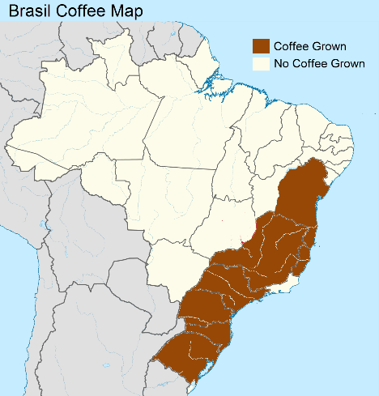
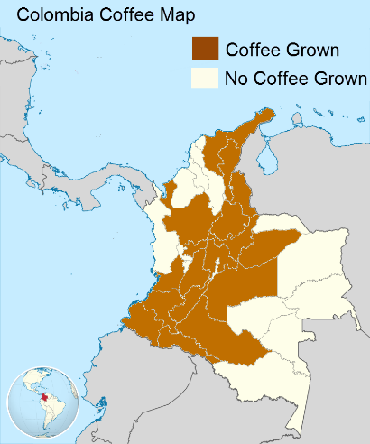
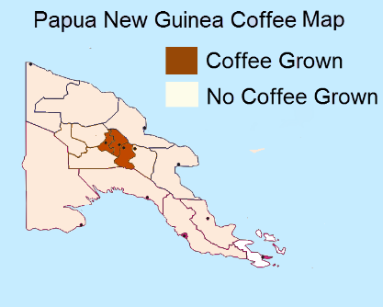
Scope
75% of all coffee produced is the arábica variety.
Brasil, Colombia and Papua New Guinea produce 48% of the world’s coffee supply.
Data from Brasil, Colombia and Papua New Guinea was included.

Slide 6
Existing Research
Magrach describes that temperature and rain affect the amount of coffee rust.
Yap explores the effect of exchange rate and import volume on futures prices.
Avelino suggests a qualitative link between coffee rust and selling prices.

Slide 7
Hypotheses
More rain increases coffee rust.
Higher temperatures increases coffee rust.
More coffee rust decreases production.
More coffee production decreases futures.
More coffee rust decreases futures.

Slide 8
Data Ethics
The data used was in the public domain and contained no personally identifiable information.
The reuse of the data for the visualization research does not violate any ethics principles.

Slide 9
Data Acquisition
Brasil: 2005-2006 and 2008-2009
Colombia: 1995, 2011-2013
Papua New Guinea: 1989-1991

Slide 10
Data Acquisition - Assumptions
The growing conditions are similar for Brasil, Colombia and Papua New Guinea
Acceptable to compare data from these countries.
Rust monthly amounts were calculated from yearly statistics.
Future are worldwide prices rather than by country.
Assume the data is accurate.

Slide 11
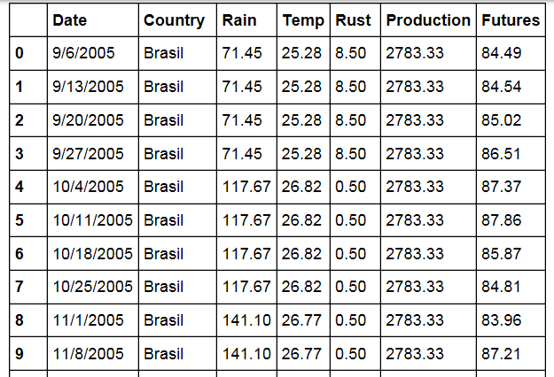
Data Acquisition
Variables :
Monthly rainfall
Monthly temperature
Percent Rust (on plants)
Monthly production amount
Bi-weekly futures prices

Slide 12
Data Acquisition - Challenges
Learn domain quickly to find relevant data
Translate documents from Portuguese and Spanish
Combine data from 10+ sources.

Slide 13
Data Acquisition - Cleaning
The ‘Date’ variable was standardized as mm/dd/yy.
All numerical values formatted to two decimal places.
‘Temperature’ variable renamed to ‘Temp.’
Country names spelled as they would be in their native language (‘Brasil’ rather than ‘Brazil’).

Slide 14
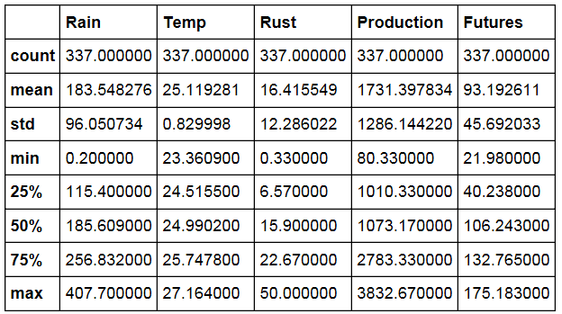
Data Analysis - Summary Statistics
Average monthly rain = 0.2 - 407.7 mm
Average monthly temperature = 23.36-27.16 C
Average monthly rust = 0.33-50%
Monthly calculated production ranges = 80.33 - 3832.67 (1000-60kg bags of beans)
Bi-weekly futures = $21.98-$175.18

Slide 15
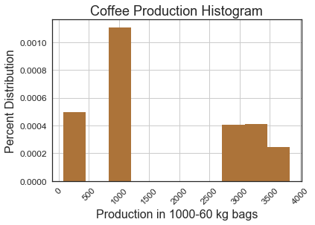
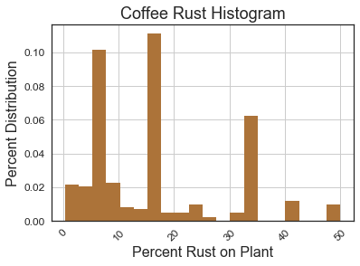
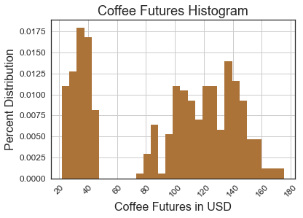
Data Analysis - Distribution
These histograms show the distribution of attributes –Production, Rust and Futures.

Slide 16
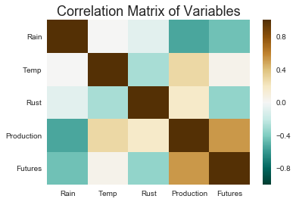
Data Analysis - Correlation
In a correlation matrix, each variable is represented as a square.
Variables that are positively correlated (> 0 ) change in the same direction.
Variables that are negatively correlated (< 0) change in the opposite direction.

Slide 17
Data Analysis – Correlation
Rain is negatively correlated to rust so an increase in rain means a decrease in rust.
Temperature is negatively correlated to rust so an increase in temperature means a decrease in rust.

Slide 18
Data Analysis - Correlation
Rust is positively correlated to production so if rust increases production increases.
Production is positively correlated with futures so if production increases futures increase.
Rust is negatively correlated with futures so if rust increases futures decrease.

Slide 19
Data Analysis – Hypotheses
More rain increases rust. (fail to accept)
Higher temperatures increase rust. (fail to accept)
More coffee rust decreases production. (fail to accept)
More coffee production decreases futures. (fail to accept)
More coffee rust decreases futures. (accept)

Slide 20
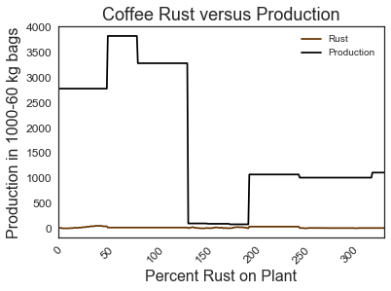
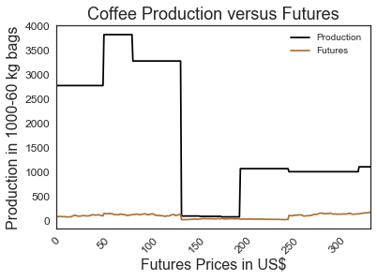
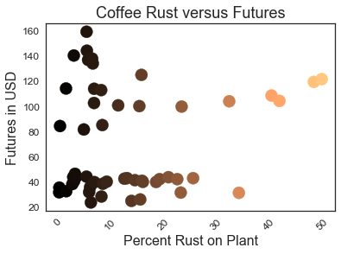
Data Analysis – Line and Scatter Plots
Rust and Production and Production and Futures may be correlated to each other.
For Rust and Futures, a scatter plot shows the data better than a line plot but the relationship is difficult to see.

Slide 21
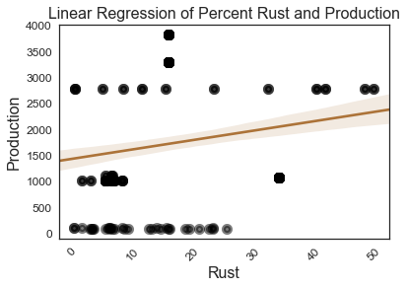
Data Analysis- Linear Regression
Linear regression visualization shows that rust and production are positively correlated.
Increase in rust = increase in production
Fail to accept original hypothesis

Slide 22
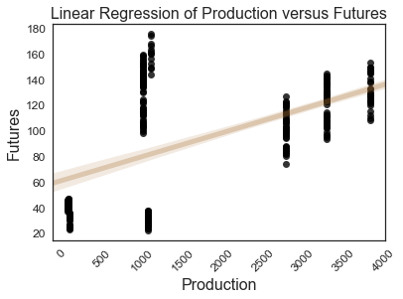
Data Analysis – Linear Regression
Linear regression visualization shows that production and futures are positively correlated to each other.
Increase in production = increase in futures
Fail to accept original hypothesis

Slide 23
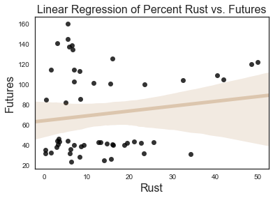
Data Analysis – Polynomial Regression
Linear regression did not best fit the data -- > polynomial fit
Positive correlation between Rust and Futures so if rusts increases so does futures.
Fail to accept the hypothesis that rust increase = futures decrease

Slide 24
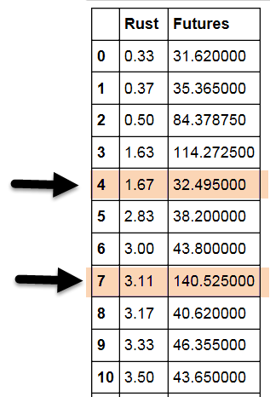
Data Analysis – Visualization Validity
The regression of rust versus futures has a positive correlation (opposite from the correlation matrix).
Use a polynomial fit to calculate root-mean-square deviation (NRMSE) and slope.
The variations in variables explains this difference so the regression plot is accurate.
Rust = 1.67, Futures = 32.49
Rust = 3.11, Futures = 140.52
 | Rust | Futures
Slope | 0.724 | 0.049
NRMSE | 0.117 | 0.040

Slide 25
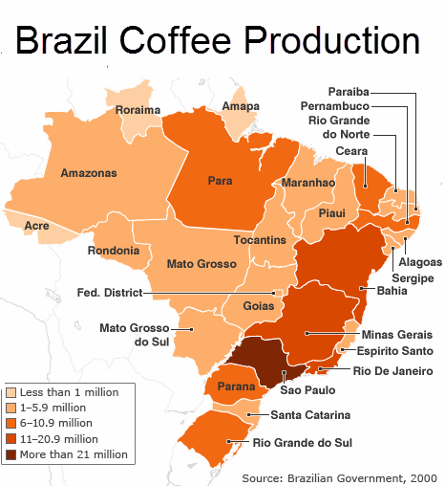
Present Results - Failed Experiments
Choropleth map showing coffee production for each country.
It only shows the production variable.

Slide 26
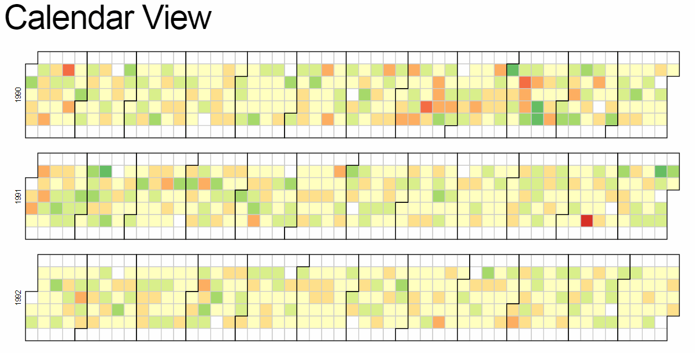
Present Results - Failed Experiments
Calendar View D3 visual showing daily futures prices in blocks
It only shows futures variable.

Slide 27
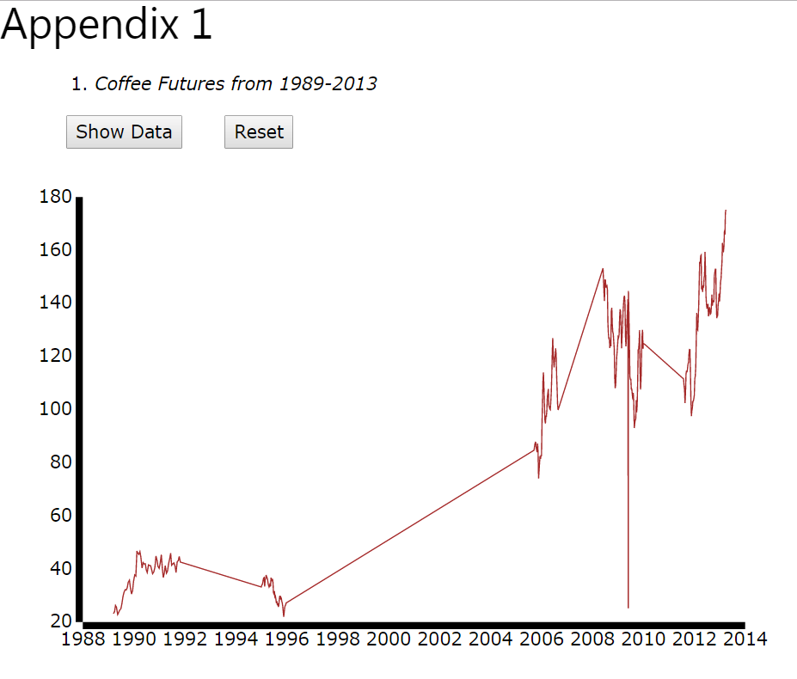
Present Results - Failed Experiments
Interactive line plot of futures over time.
Gaps in years would make data interpolation misleading.

Slide 28

Present Results – Objective
Communicate the relationships between coffee rust, production and futures prices.
Present the source data and visualizations in an easy-to-access, publically available format.

Slide 29
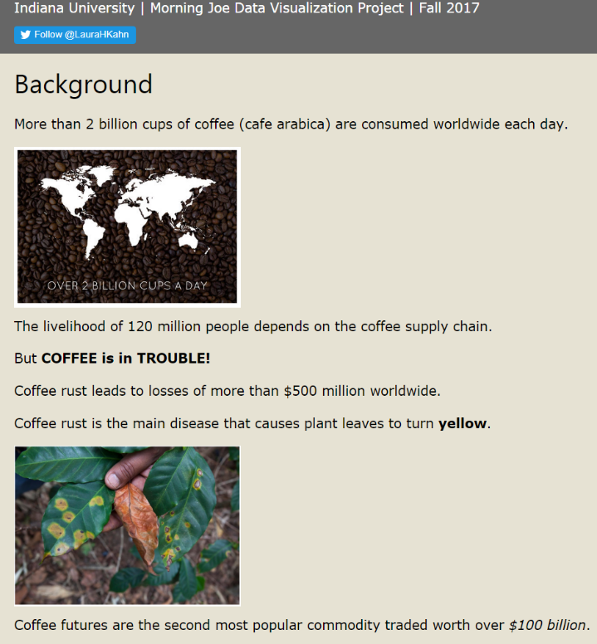

Present Results – Technical Approach
HTML OR JavaScript (WordPress) template

Slide 30

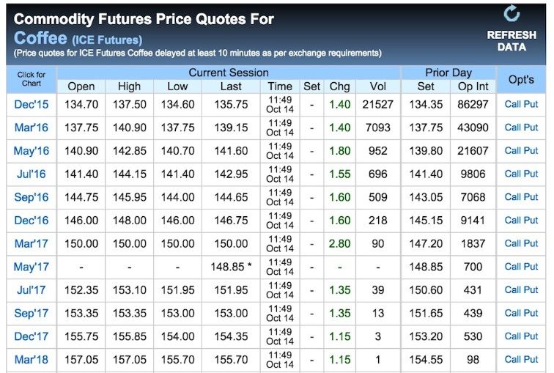
Present Results – Choosing Images
Reproducible, high resolution images were chosen to clearly communicate the story of rust, production and futures.

Slide 31

Present Results - Modifying Maps
Begin with blank administrative maps for each country (SVG)
Visually encode administrative regions that grow coffee with dark brown and regions that don’t grow coffee with light tan.
Add simple map title.
Change ocean to light blue.

Slide 32
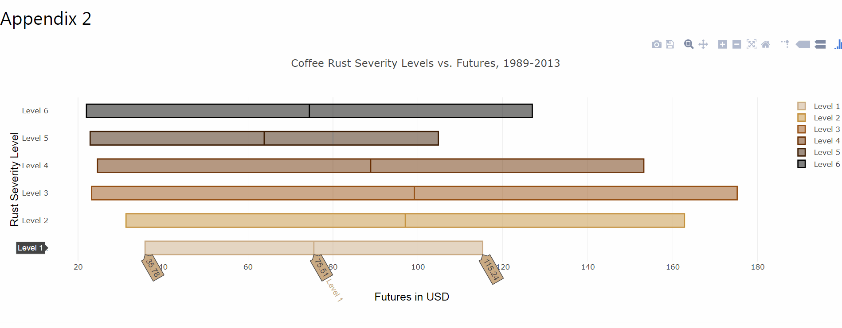
Present Results – Creating D3 Visual
Interactive box plot of coffee rust intensity level versus futures created.

Slide 33
Conclusion
Based on the visualization analysis, the original hypotheses can be accepted or not.
More rain increases rust. (Fail to accept)
Higher temperatures increase rust. (Fail to accept)
More rust decreases production. (Fail to accept)
More production decreases futures. (Fail to accept)
More rust decreases futures. (Fail to accept)
References
Website

